Slide 1
CSCE430/830 Computer Architecture
Memory Hierarchy: Performance
Lecturer: Prof. Hong Jiang
Courtesy of Yifeng Zhu (U. Maine)
Fall, 2006
Portions of these slides are derived from:
Dave Patterson © UCB

Slide 2
Cache Operation
Insert between CPU and Main Memory
Implement with fast Static RAM
Holds some of a program’s
  data
  instructions
Operation:
CPU
Processor
addr
data
Cache
Memory
addr
data
Hit: Data in Cache (no penalty)
DRAM
Memory
Miss: Data not in Cache (miss penalty)

Slide 3
Cache Performance Measures
Hit rate: fraction found in the cache
  So high that we usually talk about Miss rate = 1 - Hit Rate
Hit time: time to access the cache
Miss penalty: time to replace a block from lower level, including time to replace in CPU
  access time: time to access lower level
  transfer time: time to transfer block
Average memory-access time (AMAT)
= Hit time + Miss rate x Miss penalty (ns or clocks)

Slide 4
Memory Hierarchy Motivation:
The Principle Of Locality
Programs usually access a relatively small portion of their address space (instructions/data) at any instant of time (program working set) as a result of access locality.
Two Types of access locality:
  Temporal Locality: If an item is referenced, it will tend to be referenced again soon.
    e.g. instructions in a body of a loop
  Spatial locality: If an item is referenced, items whose addresses are close will tend to be referenced soon.
    e.g. sequential instruction execution, sequential access to elements of array
The presence of locality in program behavior makes it possible to satisfy a large percentage of program memory access needs (both instructions and operands) using faster memory levels with much less capacity than program address space.

Slide 5
Fundamental Questions
Q1: Where can a block be placed in the upper level?
(Block placement)
Q2: How is a block found if it is in the upper level?
(Block identification)
Q3: Which block should be replaced on a miss?
(Block replacement)
Q4: What happens on a write?
(Write strategy)

Slide 6
Basic Cache Design
Organized into blocks or lines
Block Contents
  tag - extra bits to identify block
  (part of block address)
  data - data or instruction words
  - contiguous memory locations
Our example:
  One-word (4 byte) block size
  30-bit tag
  Two blocks in cache
CPU
Cache
CPU
CPU
b0
tag 0
data 0
b1
CPU
CPU
tag 1
data 1
Main Memory
0x00000000
0x00000004
0x00000008
0x0000000C
0x00000000

Slide 7
Cache Example (2)
Assume:
  r1==0, r2==1, r4==2
  1 cycle for cache access
  5 cycles for main. mem. access
  1 cycle for instr. execution
At cycle 1 - PC=0x00
  Fetch instruction from memory
    look in cache
    MISS - fetch from main mem
    (5 cycle penalty)
CPU
Cache
M
I
S
S
CPU
CPU
b0
(empty)
(empty)
b1
CPU
CPU
(empty)
(empty)
Main Memory
0x00000000
L: add r1,r1,r2
0x00000004
bne r4,r1,L
0x00000008
sub r1,r1,r1
0x0000000C
L: j L
0x00000000

Slide 8
Cache Example (3)
Cycle Address Op/Instr. r1
1-5 FETCH 0x…000
CPU
6 0x…0 add r1,r1,r2 1
Cache
CPU
CPU
(empty)
0x…0
(empty)
b0
L: add r1,r1,r2
b1
CPU
CPU
(empty)
(empty)
At cycle 6
  Execute instr. add r1,r1,r2
Main Memory
0x00000000
L: add r1,r1,r2
0x00000004
bne r4,r1,L
0x00000008
sub r1,r1,r1
0x0000000C
L: j L
0x00000000

Slide 9
Cache Example (4)
Cycle Address Op/Instr. r1
1-5 FETCH 0x…0
CPU
6 0x…0 add r1,r1,r2 1
6-10 FETCH 0x…4
Cache
M
I
S
S
CPU
CPU
(empty)
0x…0
(empty)
b0
L: add r1,r1,r2
b1
CPU
CPU
(empty)
(empty)
At cycle 6 - PC=0x04
  Fetch instruction from memory
    look in cache
    MISS - fetch from main mem
    (5 cycle penalty)
Main Memory
0x00000000
L: add r1,r1,r2
0x00000004
bne r4,r1,L
0x00000008
sub r1,r1,r1
0x0000000C
L: j L
0x00000000

Slide 10
Cache Example (5)
Cycle Address Op/Instr. r1
1-5 FETCH 0x…000
CPU
6 0x…0 add r1,r1,r2 1
6-10 FETCH 0x…004
Cache
11 0x…4 bne r4,r1,L 1
CPU
CPU
(empty)
0x…0
(empty)
b0
L: add r1,r1,r2
b1
CPU
CPU
(empty)
0x…1
(empty)
bne r4,r1,L
At cycle 11
  Execute instr. bne r4,r1,L
Main Memory
0x00000000
L: add r1,r1,r2
0x00000004
bne r4,r1,L
0x00000008
sub r1,r1,r1
0x0000000C
L: j L
0x00000000

Slide 11
Cache Example (6)
Cycle Address Op/Instr. r1
1-5 FETCH 0x…0
CPU
6 0x…0 add r1,r1,r2 1
6-10 FETCH 0x…4
Cache
11 0x…4 bne r4,r1,L 1
H
I
T
CPU
CPU
(empty)
0x…0
(empty)
b0
L: add r1,r1,r2
b1
CPU
CPU
(empty)
0x…1
(empty)
11 FETCH 0x…0 1
bne r4,r1,L
Main Memory
At cycle 11 - PC=0x00
  Fetch instruction from memory
  HIT - instruction in cache
0x00000000
L: add r1,r1,r2
0x00000004
bne r4,r1,L
0x00000008
sub r1,r1,r1
0x0000000C
L: j L
0x00000000

Slide 12
Cache Example (7)
Cycle Address Op/Instr. r1
1-5 FETCH 0x…0
CPU
6 0x…0 add r1,r1,r2 1
6-10 FETCH 0x…4
Cache
11 0x…4 bne r4,r1,L 1
CPU
CPU
(empty)
0x…0
(empty)
b0
L: add r1,r1,r2
b1
CPU
CPU
(empty)
0x…1
(empty)
12 FETCH 0x…0 1
bne r1,r2,L
12 add r1,r1,r2 2
Main Memory
0x00000000
L: add r1,r1,r2
0x00000004
bne r4,r1,L
At cycle 12
  Execute add r1, r1, 2
0x00000008
sub r1,r1,r1
0x0000000C
L: j L
0x00000000

Slide 13
Cache Example (8)
Cycle Address Op/Instr. r1
1-5 FETCH 0x…0
CPU
6 0x…0 add r1,r1,r2 1
6-10 FETCH 0x…4
Cache
11 0x…4 bne r4,r1,L 1
H
I
T
CPU
CPU
(empty)
0x…0
(empty)
b0
L: add r1,r1,r2
b1
CPU
CPU
(empty)
0x…1
(empty)
12 FETCH 0x…0 1
bne r4,r1,L
12 add r1,r1,r2 2
Main Memory
12 FETCH 0x04
0x00000000
L: add r1,r1,r2
0x00000004
bne r4,r1,L
0x00000008
sub r1,r1,r1
At cycle 12 - PC=0x04
  Fetch instruction from memory
  HIT - instruction in cache
0x0000000C
L: j L
0x00000000

Slide 14
Cache Example (9)
Cycle Address Op/Instr. r1
1-5 FETCH 0x…0
CPU
6 0x…0 add r1,r1,r2 1
6-10 FETCH 0x…4
Cache
11 0x…4 bne r4,r1,L 1
CPU
CPU
(empty)
0x…0
(empty)
b0
L: add r1,r1,r2
12 FETCH 0x…0 1
b1
CPU
CPU
(empty)
0x…1
(empty)
bne r4,r1,L
12 add r1,r1,r2 2
Main Memory
12 FETCH 0x04
0x00000000
L: add r1,r1,r2
13 bne r4, r1, L
0x00000004
bne r4,r1,L
0x00000008
sub r1,r1,r1
At cycle 13
  Execute instr. bne r4, r1, L
  Branch not taken
0x0000000C
L: j L
0x00000000

Slide 15
Cache Example (10)
Cycle Address Op/Instr. r1
1-5 FETCH 0x…0
CPU
6 0x…0 add r1,r1,r2 1
6-10 FETCH 0x…4
11 0x…4 bne r4,r1,L 1
Cache
M
I
S
S
CPU
CPU
(empty)
0x…0
(empty)
12 FETCH 0x…0 1
b0
L: add r1,r1,r2
b1
CPU
CPU
(empty)
0x…1
(empty)
bne r4,r1,L
12 add r1,r1,r2 2
12 FETCH 0x04
Main Memory
13 bne r4, r1, L
0x00000000
L: add r1,r1,r2
13 FETCH 0x08
0x00000004
bne r4,r1,L
0x00000008
sub r1,r1,r1
At cycle 13 - PC=0x08
  Fetch Instruction from Memory
  MISS - not in cache
0x0000000C
L: j L
0x00000000

Slide 16
Cache Example (11)
Cycle Address Op/Instr. r1
1-5 FETCH 0x…0
CPU
6 0x…0 add r1,r1,r2 1
6-10 FETCH 0x…4
11 0x…4 bne r4,r1,L 1
Cache
CPU
CPU
(empty)
0x…0
0x…2
(empty)
L: add r1,r1,r2
12 FETCH 0x…0 1
b0
sub r1,r1,r1
b1
CPU
CPU
(empty)
0x…1
(empty)
_x0008_bne r4,r1,L
12 add r1,r1,r2 2
12 FETCH 0x04
Main Memory
13 bne r4, r1, L
0x00000000
L: add r1,r1,r2
13-17 FETCH 0x08
0x00000004
bne r4,r1,L
0x00000008
sub r1,r1,r1
At cycle 17 - PC=0x08
  Put instruction into cache
  Replace existing instruction
0x0000000C
L: j L
0x00000000

Slide 17
Cache Example (12)
Cycle Address Op/Instr. r1
1-5 FETCH 0x…0
CPU
6 0x…0 add r1,r1,r2 1
6-10 FETCH 0x…4
11 0x…4 bne r4,r1,L 1
Cache
12 FETCH 0x…0 1
b0
0x…2
sub r1,r1,r1
b1
CPU
CPU
(empty)
0x…1
(empty)
_x0008_bne r4,r1,L
12 add r1,r1,r2 2
12 FETCH 0x04 2
Main Memory
13 bne r4, r1, L 2
0x00000000
L: add r1,r1,r2
13-17 FETCH 0x08 2
0x00000004
bne r4,r1,L
18 sub r1, r1, r1 0
0x00000008
sub r1,r1,r1
0x0000000C
L: j L
At cycle 18
  Execute sub r1, r1, r1
0x00000000

Slide 18
Cache Example (13)
Cycle Address Op/Instr. r1
1-5 FETCH 0x…0
CPU
6 0x…0 add r1,r1,r2 1
6-10 FETCH 0x…4
11 0x…4 bne r4,r1,L 1
Cache
12 FETCH 0x…0 1
M
I
S
S
CPU
CPU
(empty)
0x…0
(empty)
L: add r1,r1,r2
b0
sub r1,r1,r1
12 add r1,r1,r2 2
b1
CPU
CPU
(empty)
0x…1
(empty)
_x0008_bne r4,r1,L
12 FETCH 0x04 2
13 bne r4, r1, L 2
Main Memory
13-17 FETCH 0x08 2
0x00000000
L: add r1,r1,r2
18 sub r1, r1, r1 0
0x00000004
bne r4,r1,L
18 FETCH 0x0C
0x00000008
sub r1,r1,r1
At cycle 18
  Fetch instruction from memory
  MISS - not in cache
0x0000000C
L: j L
0x00000000

Slide 19
Cache Example (14)
Cycle Address Op/Instr. r1
1-5 FETCH 0x…0
CPU
6 0x…0 add r1,r1,r2 1
6-10 FETCH 0x…4
11 0x…4 bne r4,r1,L 1
Cache
12 FETCH 0x…0 1
CPU
CPU
(empty)
0x…0
0x…2
(empty)
L: add r1,r1,r2
b0
sub r1,r1,r1
12 add r1,r1,r2 2
b1
CPU
CPU
(empty)
0x…1
0x…3
(empty)
_x0008_bne r1,r2,L
j L
12 FETCH 0x04 2
13 bne r4, r1, L 2
Main Memory
13-17 FETCH 0x08 2
0x00000000
L: add r1,r1,r2
18 sub r1, r1, r1 0
0x00000004
bne r4,r1,L
18-22 FETCH 0x0C
0x00000008
sub r1,r1,r1
At cycle 22
  Put instruction into cache
  Replace existing instruction
0x0000000C
L: j L
0x00000000

Slide 20
Cache Example (15)
Cycle Address Op/Instr. r1
1-5 FETCH 0x…0
CPU
6 0x…0 add r1,r1,r2 1
6-10 FETCH 0x…4
11 0x…4 bne r3,r1,L
Cache
11 FETCH 0x…0
CPU
CPU
(empty)
0x…2
(empty)
b0
sub r1,r1,r1
12 0x…8 add r1,r1,r2 2
b1
CPU
CPU
(empty)
0x…3
(empty)
j L
12 FETCH 0x…4
13 0x…4 bne r4,r1,L
Main Memory
13-17 FETCH 0x…8
0x00000000
L: add r1,r1,r2
18 0x…8 sub r1,r1,r1 0
0x00000004
bne r4,r1,L
18-22 FETCH 0x..C
0x00000008
sub r1,r1,r1
23 0x…8 j L
0x0000000C
L: j L
At cycle 23
  Execute j L
0x00000000

Slide 21
Compare No-cache vs. Cache
NO CACHE
CACHE
Cycle Address Op/Instr.
Cycle Address Op/Instr.
1-5 FETCH 0x…0
M
1-5 FETCH 0x…0
6 0x…0 add r1,r1,r2
6 0x…0 add r1,r1,r2
6-10 FETCH 0x…4
M
6-10 FETCH 0x…4
11 0x…4 bne r4,r1,L
11 0x…4 bne r4,r1,L
11-15 FETCH 0x…0
H
11 FETCH 0x…0
16 0x…0 add r1,r1,r2
12 0x…0 add r1,r1,r2
16-20 FETCH 0x…4
H
12 FETCH 0x…4
21 0x…4 bne r4,r1,L
13 0x…4 bne r4,r1,L
21-25 FETCH 0x…8
M
13-17 FETCH 0x…8
26 0x…8 sub r1,r1,r1
18 0x…8 sub r1,r1,r1
26-30 FETCH 0x..C
M
18-22 FETCH 0x..C
31 0x…C j L
23 0x…C j L

Slide 22
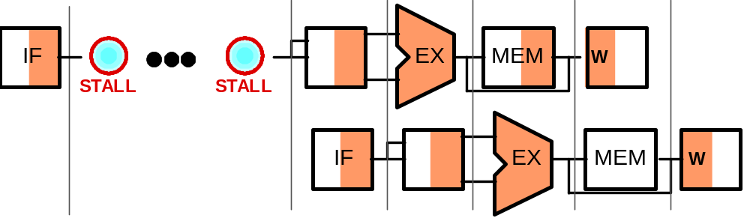
Cache Miss and the MIPS Pipeline
Instruction Fetch
Compare in
Cycle 1
Miss Detected
in Cycle 2
Fetch Completes
(Pipeline Restarts)
Clock
Cycle 1
Clock
Cycle 2+N
Clock
Cycle 3+N
Clock
Cycle 4+N
Clock
Cycle 5+N
Clock
Cycle 6+N

Slide 23
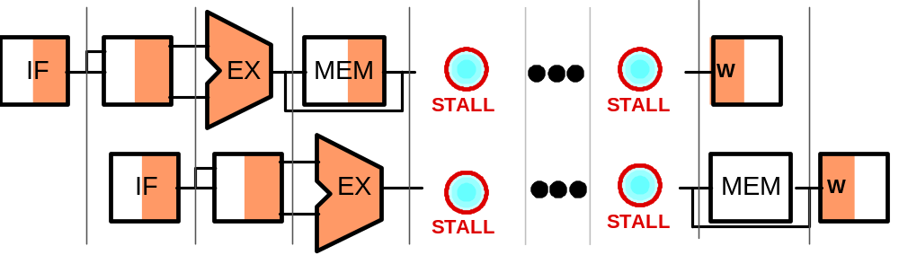
Cache Miss and the MIPS Pipeline
Load Instruction
Compare in
Cycle 4
Miss Detected
in Cycle 5
Load Completes
(Pipeline Restarts)
Clock
Cycle 1
Clock
Cycle 2
Clock
Cycle 3
Clock
Cycle 4
Clock
Cycle 5
Clock
Cycle 5+N
Clock
Cycle 6+N

Slide 24
Cache Performance Measures
Hit rate: fraction found in the cache
  So high that we usually talk about Miss rate = 1 - Hit Rate
Hit time: time to access the cache
Miss penalty: time to replace a block from lower level, including time to replace in CPU
  access time: time to access lower level
  transfer time: time to transfer block
Average memory-access time (AMAT)
= Hit time + Miss rate x Miss penalty (ns or clocks)

Slide 25
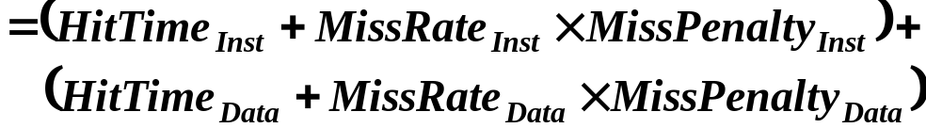
Cache performance
Miss-oriented Approach to Memory Access:
  CPI_{Execution} includes ALU and Memory instructions
Separating out Memory component entirely
  AMAT = Average Memory Access Time
  CPI_{ALUOps} does not include memory instructions

Slide 26
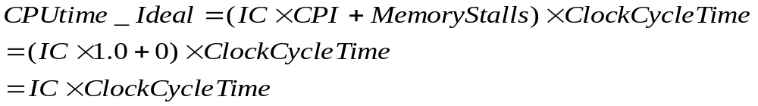
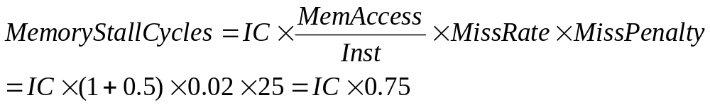
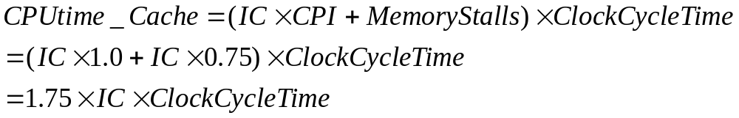
Cache Performance Example
Assume we have a computer where the clock per instruction (CPI) is 1.0 when all memory accesses hit in the cache. The only data accesses are loads and stores, and these total 50% of the instructions. If the miss penalty is 25 clock cycles and the miss rate is 2% (Unified instruction cache and data cache), how much faster would the computer be if all instructions and data were cache hit?
When all instructions are hit
In reality:

Slide 27
Performance Example Problem
Assume:
  For gcc, the frequency for all loads and stores is 36%.
  instruction cache miss rate for gcc = 2%
  data cache miss rate for gcc = 4%.
  If a machine has a CPI of 2 without memory stalls
  and the miss penalty is 40 cycles for all misses,
how much faster is a machine with a perfect cache?
Instruction miss cycles = IC x 2% x 40 = 0.80 x IC
Data miss cycles = IC x 36% x 4% x 40 = 0.576 x IC
CPIstall = 2 + ( 0.80 + 0.567 ) = 2 + 1.376 = 3.376
IC x CPIstall x Clock period 3.376
=
=
1.69
IC x CPIperfect x Clock period 2

Slide 28
Performance Example Problem
Assume: we increase the performance of the previous machine by doubling its clock rate. Since the main memory speed is unlikely to change, assume that the absolute time to handle a cache miss does not change. How much faster will the machine be with the faster clock?
For gcc, the frequency for all loads and stores is 36%
Instruction miss cycles = IC x 2% x 80 = 1.600 x IC
Data miss cycles = IC x 36% x 4% x 80 = 1.152 x IC
2.752 x IC
I x CPI_{slowClk} x Clock period 3.376
I x CPI_{fastClk} x Clock period 4.752 x 0.5
=
= 1.42 (not 2)

Slide 29
Four Key Cache Questions:
1. Where can block be placed in cache?
(block placement)
2. How can block be found in cache? …using a tag
(block identification)
3. Which block should be replaced on a miss?
(block replacement)
4. What happens on a write?
(write strategy)

